Slide 1



Sentiment Analysis
Extra Tutorial Support
Dr. Farshid Keivanian
The University of Newcastle
Farshid.Keivanian@newcastle.edu.au

Slide 2

Topics for discussion
1) What is Sentiment Analysis?
2) Case Study 1: Sentiment Analysis on Social Media
3) Case Study 2: Sentiment Analysis on Financial News
4) Recent Research Areas and References

Slide 3
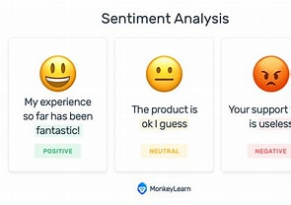
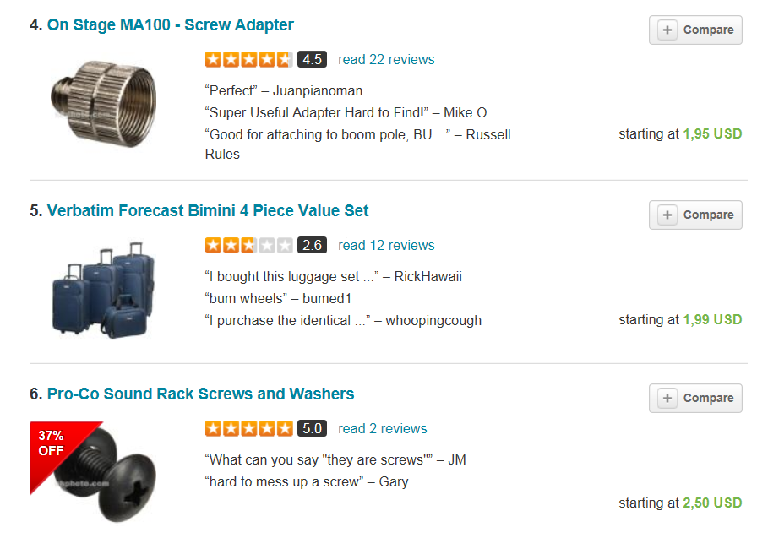
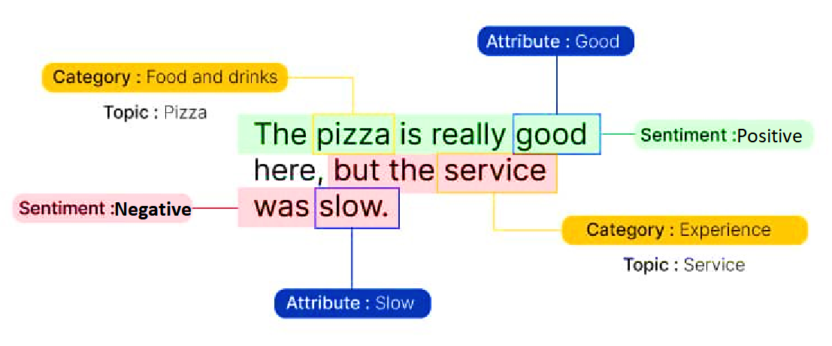
1 | Sentiment Analysis
Definition: It is the process of classifying text as either positive, negative, or neutral.
Why is sentiment analysis useful: It is essential for businesses to gauge customer response.
A simple example:
Notes:
Your company has just released a new product that is being advertised on a number of different channels.
In order to gauge customer’s response to this product, sentiment analysis can be performed.
Customers usually talk about products on social media and customer feedback forums. This data can be collected and analyzed to gauge overall customer response.
Taking this a step further, trends in the data can also be examined. For example, customers of a certain age group and demographic may respond more favourably to a certain product than others. Based on the information collected, companies can then position the product differently or change their target audience. It’s useful for analysing:
Customer feedback
Online product reviews
Survey responses
Social media monitoring
Reputation management
Customer experience
Healthcare materials
Mental illness (anxiety, depression, suicide ideation)
Etc.

Slide 4

2 | Sentiment Analysis on Social Media
Step 1. Read the Data frame: We will be using the Reviews.csv file from Kaggle’s Amazon Fine Food Reviews dataset to perform the analysis.
Python code
Text — This variable contains the complete product review information.
Summary — This is a summary of the entire review.
Score — The product rating provided by the customer.
Notes:
We perform sentiment analysis on a large amount of data. We can see that the Data frame contains some product, user and review information.
The data that we will be using most for this analysis is “Summary”, “Text”, and “Score.”

Slide 5
2 | Sentiment Analysis on Social Media
Step 2. Install required libraries and Data Analysis: We will take a look at the variable “Score” to see if majority of the customer ratings are positive or negative. To do this, you will have to install the Plotly library first.
Python code
From here, we can see that most of the customer rating is positive. This leads me to believe that most reviews will be
pretty positive too, which will be analyzed in a while.

Slide 6
2 | Sentiment Analysis on Social Media
Step 2. Install required libraries and Data Analysis: Now, we can create some wordclouds to see the most frequently used words in the reviews.
Python code
Some popular words that can be observed here include “taste,” “product,” “love,” and “Amazon.” These words are mostly positive, also indicating that most reviews in the dataset express a positive sentiment.
Notes:
Now, we can create some wordclouds to see the most frequently used words in the reviews.

Slide 7
2 | Sentiment Analysis on Social Media
Step 3. More data Analysis: we will classify reviews into “positive” and “negative,” so we can use this as training data for our sentiment classification model.
Python code
All reviews with ‘Score’ < 3 will be classified as -1. Reviews with ‘Score’ = 3 will be dropped, because they are neutral. Our model will only classify positive and negative reviews.

Slide 8
2 | Sentiment Analysis on Social Media
Step 3. More data analysis: Looking at the head of the data frame now, we can see a new column called ‘sentiment:’

Slide 9
2 | Sentiment Analysis on Social Media
Step 3. More data analysis: Now that we have classified tweets into positive and negative, let’s build wordclouds for each!
First, we will create two data frames — one with all the positive reviews, and another with all the negative reviews.
Wordcloud — Positive Sentiment
Python code

Slide 10
2 | Sentiment Analysis on Social Media
Step 3. More data analysis: Wordcloud – Negative Sentiment
Python code

Slide 11
2 | Sentiment Analysis on Social Media
Step 3. More data analysis: Wordcloud – Negative Sentiment
As seen above, the positive sentiment word cloud was full of positive words, such as “love,” “best,” and “delicious.”
The negative sentiment word cloud was filled with mostly negative words, such as “disappointed,” and “yuck.”
The words “good” and “great” initially appeared in the negative sentiment word cloud, despite being positive words. This is probably because they were used in a negative context, such as “not good.” Due to this, I removed those two words from the word cloud.

Slide 12
2 | Sentiment Analysis on Social Media
Step 3. More data analysis: Distribution of reviews with sentiment across the dataset
Python code

Slide 13
2 | Sentiment Analysis on Social Media
Step 4. Building the Model
Finally, we can build the sentiment analysis model!
This model will take reviews in as input. It will then come up with a prediction on whether the review is positive or negative.
This is a classification task, so we will train a logistic regression model to do it.
Step 4.1: Pre-processing – not for this example! Step 4.2: Data Cleaning
We will be using the summary data to come up with predictions. First, we need to remove all punctuation from the data.
Python code

Slide 14
2 | Sentiment Analysis on Social Media
Step 4. Building the Model
Step 4.3: Split the data frame
The new data frame should only have two columns — “Summary” (the review text data), and “sentiment” (the target variable):
Python code
We will now split the data frame into train and test sets. 80% of the data will be used for training, and 20% will be used for testing:
Notes:
- Taking a look at the head of the new data frame, this is the data it will now contain.

Slide 15
2 | Sentiment Analysis on Social Media
Step 4. Building the Model
Step 4.4 : Create a bag of words
Next, we will use a count vectorizer from the Scikit-learn library.
This will transform the text in our data frame into a bag of words model, which will contain a sparse matrix of integers. The number of occurrences of each word will be counted and printed.
We will need to convert the text into a bag-of-words model since the logistic regression algorithm cannot understand text.
Python code

Slide 16
2 | Sentiment Analysis on Social Media
Step 4. Building the Model
Step 4.5: Import Logistic Regression
Python code

Slide 17
2 | Sentiment Analysis on Social Media
Step 4. Building the Model
Step 4.6: Split target and independent variables
Step 4.7: Fit model on data
Python code
Step 4.8: Make predictions
Now, we can test the accuracy of our model!
Step 5. Check accuracy for the model
Notes:
We have successfully built a simple logistic regression model and trained the data on it. We also made predictions using the model.

Slide 18
2 | Sentiment Analysis on Social Media
Step 5. Check the accuracy of the model
The overall accuracy of the model on the test data is around 93%, which is pretty good considering we didn’t do any feature extraction or much preprocessing.
Python code
Classification report

Slide 19

3 | Sentiment Analysis on Financial News
Step 1. Read the Data frame: This dataset contains the sentiments for financial news headlines from the perspective of a retail investor. Further details about the dataset can be found in:
Malo, P., Sinha, A., Takala, P., Korhonen, P. and Wallenius, J. (2014): “Good debt or bad debt: Detecting semantic orientations in economic texts.” Journal of the American Society for Information Science and Technology.
Notes:
# Read Dataset
# Dataset Details
# messages : the text of news
# labels : type of news(neutral,positive,negative)
# target : the polarity of the news (0 = negative, 2 = neutral, 4 = positive)

Slide 20
3 | Sentiment Analysis on Financial News
Step 2. Install required libraries and Data Analysis: We check for the null values. We will take a look at the variable “lables” and map each label to a string; Negative: 0, Neutral: 2, Positive: 4
Python code

Slide 21
3 | Sentiment Analysis on Financial News
Step 2. Install required libraries and Data Analysis: We check for the null values. We will take a look at the variable “lables” and map each label to a string; Negative: 0, Neutral: 2, Positive: 4
Python code

Slide 22
3 | Sentiment Analysis on Financial News
Step 3. More data analysis: We check for the null values. We will take a look at the variable “lables” and map each label to a string; Negative: 0, Neutral: 2, Positive: 4
Python code

Slide 23
3 | Sentiment Analysis on Financial News
Step 3. More data analysis: We demonstrate the distribution of sentiments:
Python code
Step 4. Building the Model
We do text preprocessing
Notes:
# We used CountVectorizer to transform a given text into a vector on the basis of the frequency of each word that occurs in the entire text.
In [11]:

Slide 24
3 | Sentiment Analysis on Financial News
Step 4. Building the Model
We used CountVectorizer to transform a given text into a vector on the basis of the frequency of each word that occurs in the entire text.
Python code
Dependent feature
List of feature names
Notes:
In [11]:

Slide 25
3 | Sentiment Analysis on Financial News
Step 4. Building the Model
We build a Multinomial Naive Bayes, a logistic regression model, and a support vector machine model:
Python code
Notes:
In [11]:

Slide 26
3 | Sentiment Analysis on Financial News
Step 5. Check the accuracy of each model to determine the best classifier
Python code

Slide 27
3 | Sentiment Analysis on Financial News
Step 5. Check the accuracy of each model to determine the best classifier
Notes:
In [11]:

Slide 28
3 | Sentiment Analysis on Financial News
Step 5. Check the accuracy of each model to determine the best classifier
Notes:
In [11]:

Slide 29
4 | Recent Research Areas and References
1. Sentiment analysis for automatic detection of depression through an analysis of social media messages:
Chiong, R., Budhi, G. S., & Dhakal, S. (2021). Combining sentiment lexicons and content-based features for depression detection. IEEE Intelligent Systems, 36(6), 99-105.
Notes:
Several studies in mental health problems say that social media posts could be utilised to monitor health issues.
* People express their opinions and share their thinking on social media platforms.
* Tweets posted by a major depressive disorder person could be utilised to predict future episodes of depression.
* A survey found that an increasing number of people, especially teenagers and young adults, are turning to social media to express their feelings.

Slide 30
4 | Recent Research Areas and References
2. Machine learning for predicting the sentiment of online customer reviews:
Budhi, G. S., Chiong, R., Pranata, I., & Hu, Z. (2021). Using machine learning to predict the sentiment of online reviews: a new framework for comparative analysis. Archives of Computational Methods in Engineering, 28(4), 2543-2566.

